Slide 1




Data Career Insights: A Comprehensive Analysis and Future Predictions
Aditya Tekale
Akshit Tyagi
Niranjan Rao
Tanya Yadav
Department of Applied Data Science San Jose State University Data 230: Data Visualization
Notes:
Hello everyone, we'll be presenting our project which is based on jobs in Data. Our team, consisting of Aditya , Akshit, myself, and Tanya , has put together this analysis to explore the world of data-related careers. We will go through key insights, visualizations, and trends that are shaping the future of the data industry.

Slide 2

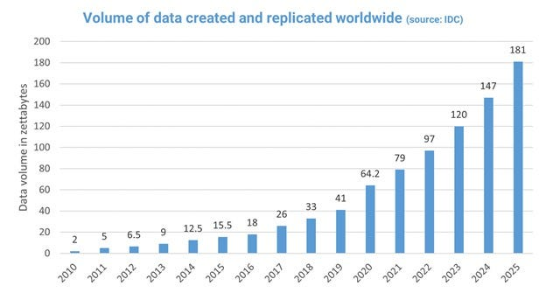
Data Industry
Data is now considered the 'new oil'—a vital resource driving innovation, efficiency, and competitive advantage across industries.
As the data industry grows, so does the demand for roles like Data Scientists, Engineers, Analysts, and Machine Learning Engineers
Companies today rely heavily on data-driven decisions, creating a high demand for skilled professionals.
Notes:
As you all know, data is often referred to as the 'new oil,' powering decision-making, innovation, and competitive advantages across industries.
The amount of data generated globally is expected to grow from 79 zettabytes in 2021 to over 180 zettabytes by 2025, creating business opportunities and demand for skilled professionals.
Now that we understand how data is driving the world, let’s focus on the purpose of our project.

Slide 3
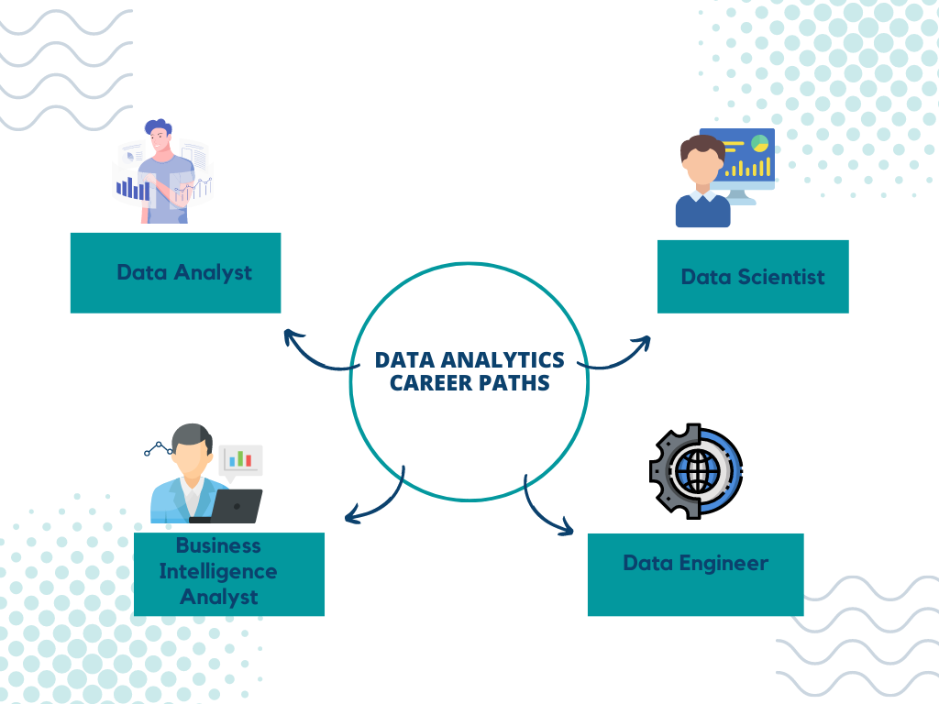
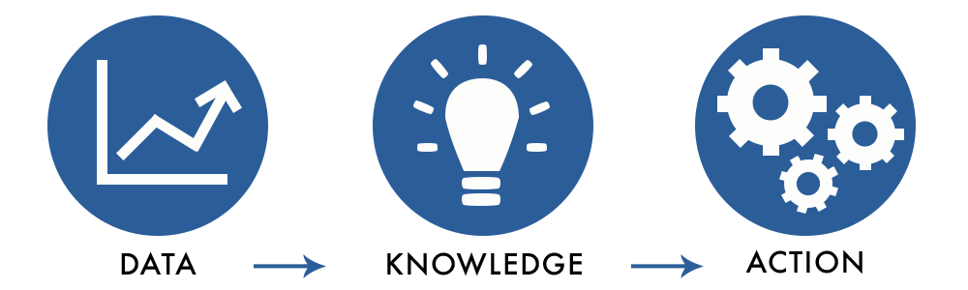
Aim & Goals
This project aims to explore job trends in the data field, provide insights for career decision-making, and predict future salary trends to showcase the growth of this field.
Whether you are starting your career or considering a transition into the data field, this analysis will guide you to make informed choices based on data-driven insights.
The goal is to provide actionable insights to help make data informed decisions.
Notes:
The aim for our project is that it serves as a guide for anyone who is interested in the data field—whether they’re starting fresh or making a career shift. This can help them identify opportunities, understand trends and then plan their next steps accordingly. It can also help organizations to adjust their hiring strategies accordingly.
We are hoping that our analysis will help answer business questions like -
Which job titles are most in demand?
What are the salary ranges across different regions?
How do remote, hybrid, and in-person roles compare?
What does the future hold for salaries in the data industry?
Now, Let’s look into the dataset we chose for this project.

Slide 4


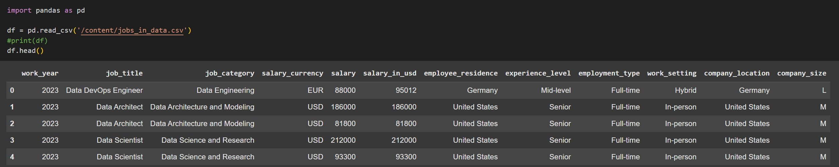
Dataset Overview
Source : Kaggle
Number of Columns : 12
Number of Rows : 10418
Source: Dataset​
Notes:
The Dataset we chose is sourced from Kaggle, containing 12 columns and 10,418 rows, The dataset offers a wide range of information, from job roles to salaries, geographic locations, and more. With such detailed data, we were able to conduct thorough analyses, the results of which we’ll share shortly.

Slide 5
EDA
Notes:
To ensure meaningful analysis, we started with EDA.
This was a crucial step in our analysis for identifying patterns and relationships in the data.

Slide 6
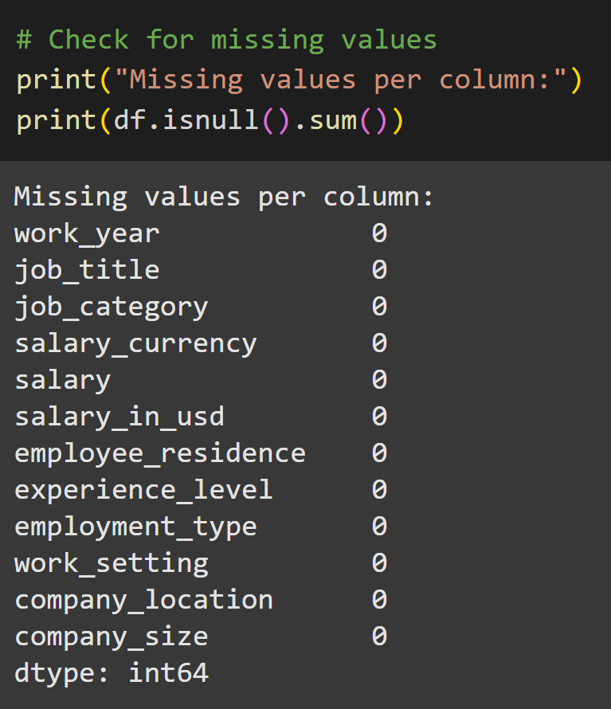
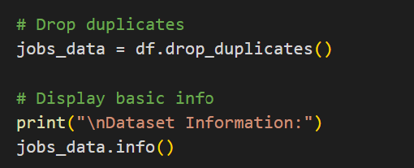
Explanatory Data Analysis
Step 1 : Data Cleaning and Preprocessing
Why : Data preprocessing ensures data consistency, removes redundancies, and prepares the dataset for accurate analysis and meaningful insights.
How : Missing Values Check , Duplicate Removal
Link: Google Colab
Notes:
The first step in our EDA was data cleaning and preprocessing. This involved handling missing values and duplicates to ensure the data was consistent.
For instance, we verified there were no null values in critical columns, which enabled us to confidently proceed with our analysis.

Slide 7
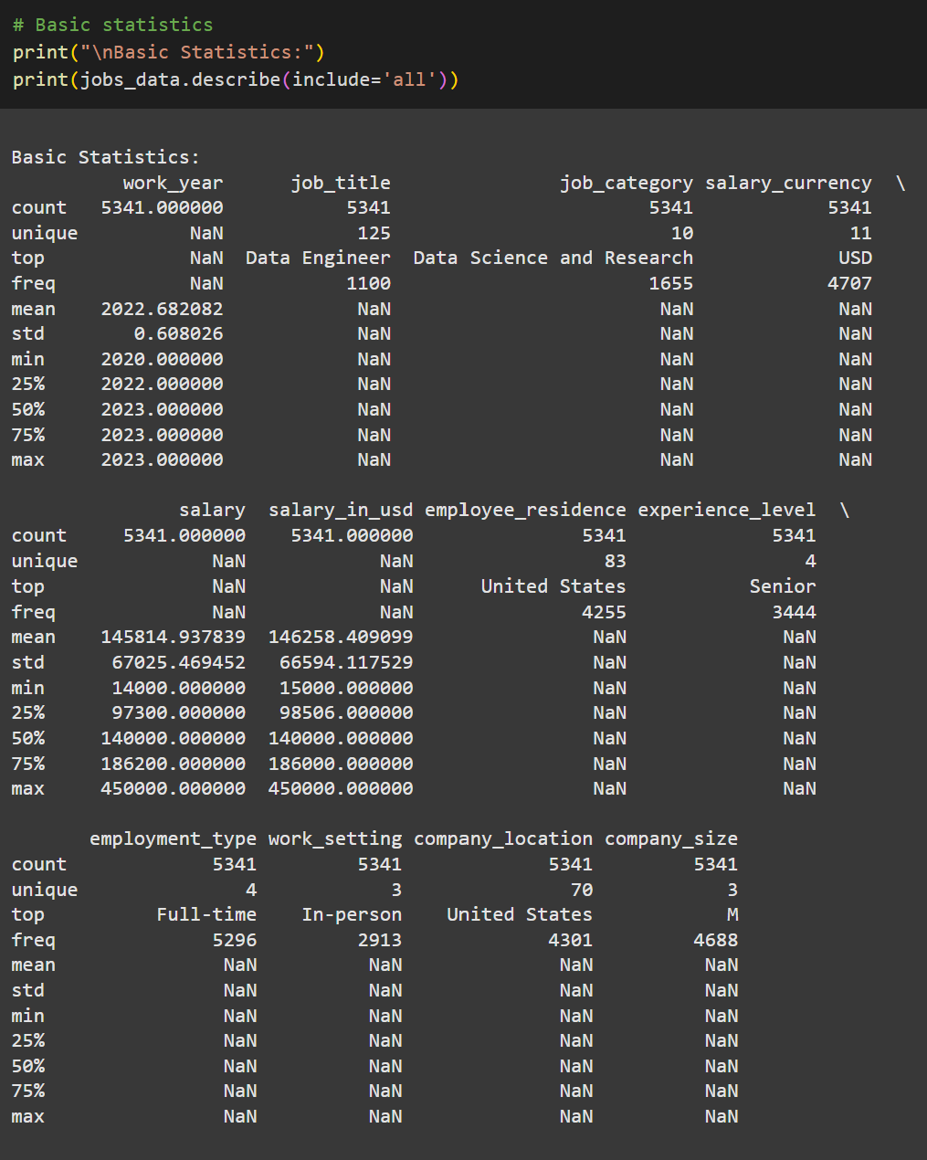
Explanatory Data Analysis
Step 2 : Statistical Summary
Why : Data preprocessing ensures data consistency, removes redundancies, and prepares the dataset for accurate analysis and meaningful insights.
How : Descriptive statistics - (describe(include='all'))
Link: Google Colab
Notes:
Step 2 was generating descriptive statistics for the dataset. This helped us understand measures such as mean, median, and standard deviation across numerical columns.

Slide 8
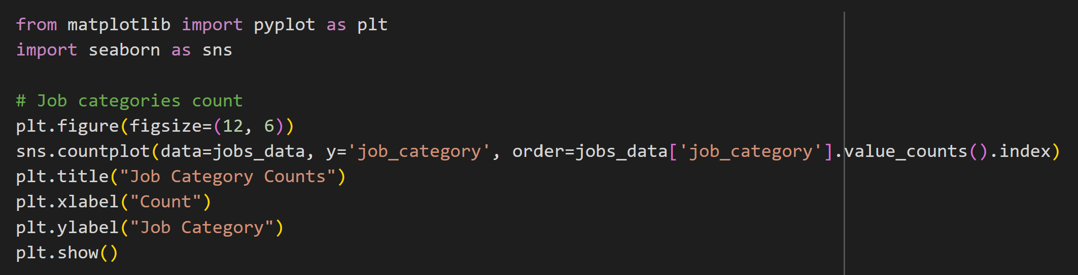
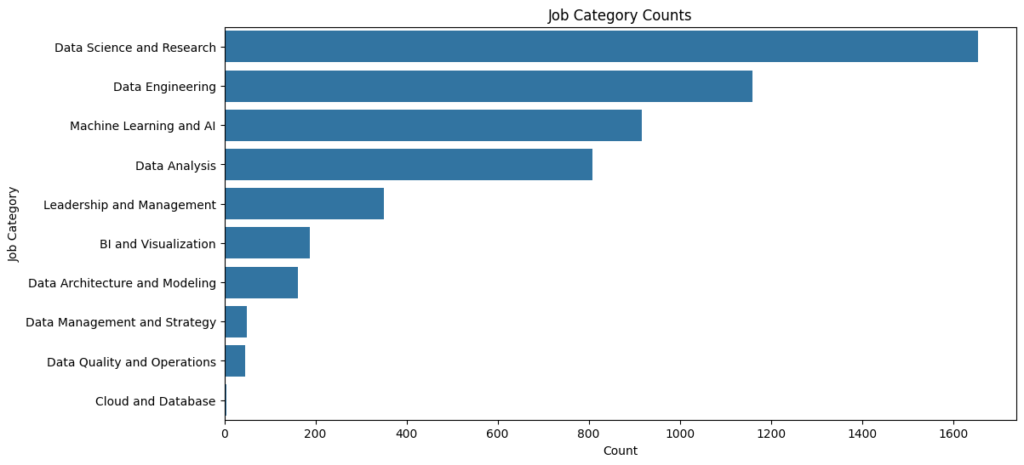
Explanatory Data Analysis
Step 3 : Categorical Analysis
Why : Categorical analysis performed to gain insights from qualitative data by identifying patterns and relationships between different categories.
How : Visualized job category distributions using a horizontal bar chart, counted occurrences of each job category to identify the most and least common roles.
Notes:
Step 3 was performing a Categorical analysis.
We used a horizontal bar chart to visualize the distribution of job categories, highlighting which roles were most and least common. Data Science and Research had the most jobs whereas Cloud and Database category had the least.

Slide 9
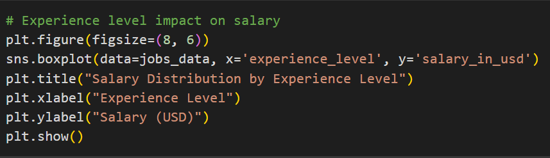
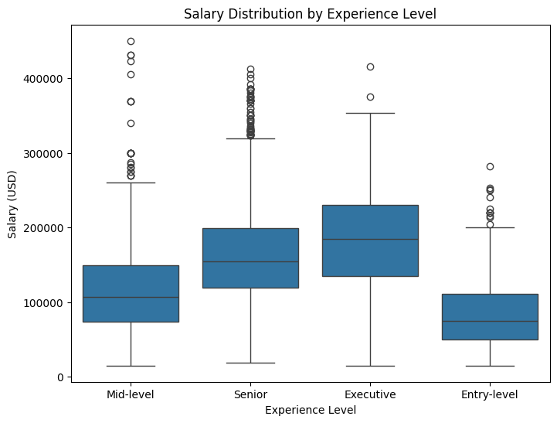
Explanatory Data Analysis
Step 3 : Categorical Analysis
Why : Categorical analysis performed to gain insights from qualitative data by identifying patterns and relationships between different categories.
How : Explored the relationship between experience levels and salaries using a boxplot, visualized the distribution of salaries for each experience level category.
Notes:
Additionally, we examined the relationship between experience levels and salaries
As expected, From the boxplot we can see that Entry-level roles have the lowest median salary, followed by Mid-level, Senior and Executive positions.

Slide 10
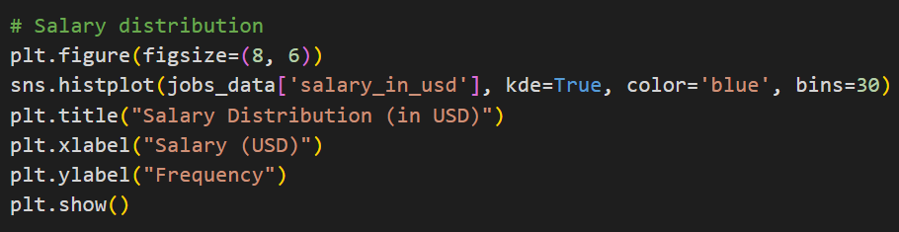
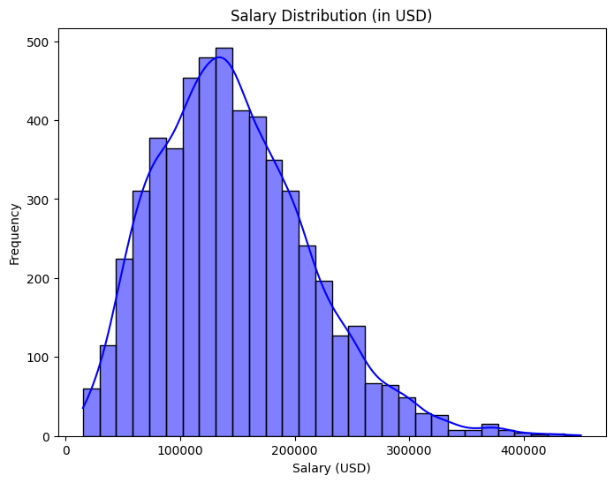
Explanatory Data Analysis
Step 4 : Numerical Analysis
Why : Numerical Analysis is performed to gain a deeper understanding of the distribution and characteristics of numerical variables within a dataset
How : Analyzed the distribution of salaries using a histogram with kernel density estimation (KDE) overlay, visualized the spread, central tendency, and skewness of salary data.
Notes:
For the next step we performed numerical analysis to understand the distribution of salaries.
We can observe that salaries are right-skewed which means that majority of the job roles have a common salary band. The long tail on the right shows outliers which represents high-paying senior or executive-level positions.

Slide 11
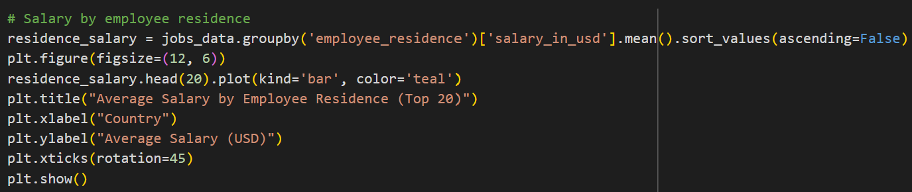
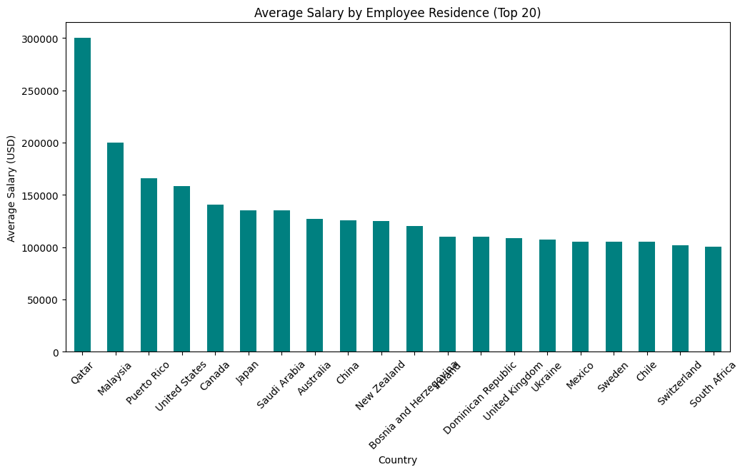
Explanatory Data Analysis
Step 5 : Geographical Analysis
Why : Geographical Analysis is performed to understand how data is distributed across a geographic space, revealing patterns, clusters, outliers, and spatial relationships that might not be apparent from looking at the data alone
How : Analyzed the relationship between employee residence and average salary, Visualized the top 20 countries with the highest average salaries using a bar chart.
Notes:
For step 5 we performed geographical analysis, where we explored salary data by location, identifying the top 20 countries with the highest average salaries. The bar chart showed Qatar, having the highest average salary in our dataset.

Slide 12
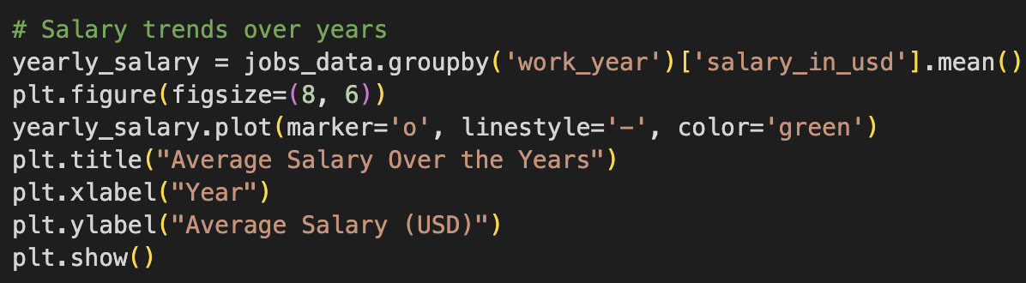
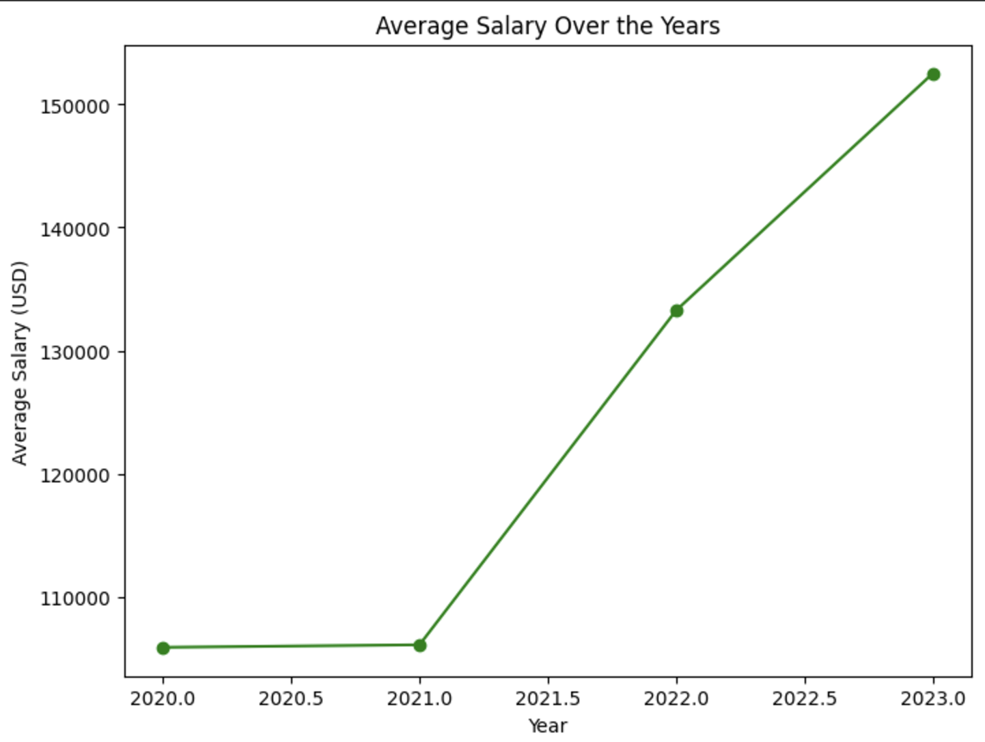
Explanatory Data Analysis
Step 6 : Trends Over Time Analysis
Why : Trends Over Time Analysis helps identify patterns, changes, and potential correlations over time, enabling better forecasting and strategic decision-making.
How : Analyzed the average salary trends across years to uncover historical patterns in salary growth, aggregated the data by work_year and visualized it using a line plot to depict trends effectively.
Notes:
Finally for our last step, we analyzed salary trends over time. Using a line plot, we tracked salary growth across years. Here we can observe steady growth in salaries, the peak could indicate high-demand roles, and the dips are possibly linked to external factors like economic shifts.

Slide 13
POWER BI
Notes:
We then proceeded to visualize our dataset using Power BI

Slide 14
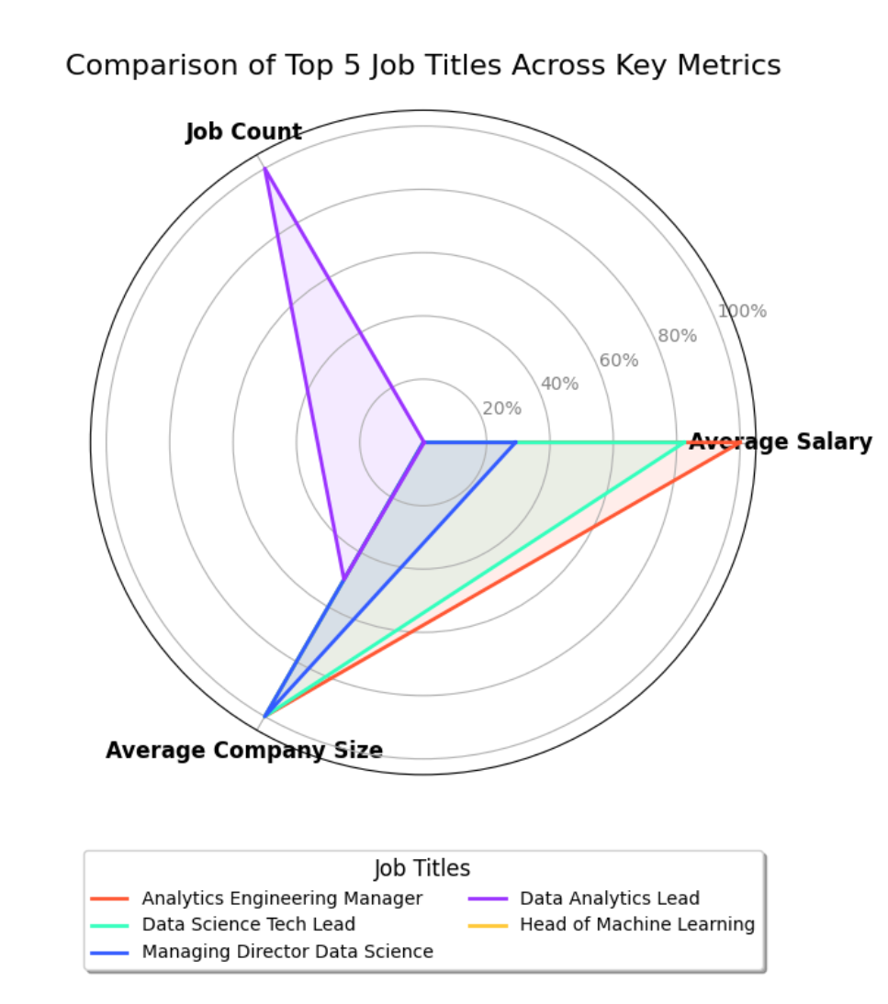
Visualization
Senior roles like Executive positions show higher salaries with notable outliers, reflecting significant pay variation in leadership roles.
Mid-level roles show fewer anomalies, suggesting consistency in salaries compared to Entry-level or Executive roles, where variation is greater.
Higher anomalies in Senior roles may indicate a preference for experienced professionals in larger organizations, while smaller companies may have more consistent salary structures.
Entry-level roles show dense clusters with lower anomalies, reflecting standardization in starting salaries and higher availability compared to specialized roles.
Notes:
Here we have a radar chart comparing the top 5 job titles across Average Salary, Job Count, and Company Size. Wider triangles, like for Data Analytics Lead, show balanced performance across metrics, while narrower ones, like Managing Director, highlight specialization this means higher salaries but fewer job openings. Entry-level and mid-level roles have the highest job counts
Transition to next slide: now lets see what the ten top paying jobs are.

Slide 15
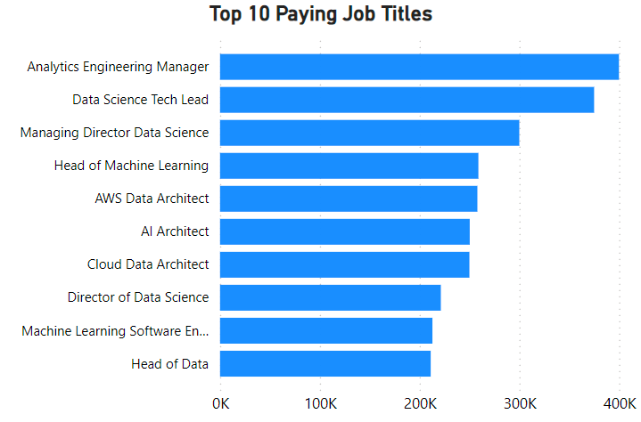
Visualization
Analytics Engineering Manager and Data Science Tech Lead are the highest-paying roles, with salaries over 400K USD.
Specialized technical roles like "AWS Data Architect" and "AI Architect" rank high, reflecting their niche value. Highlight how the roles align with market demand.
Mid-level roles like "Machine Learning Software Engineer" offer competitive salaries but remain below leadership positions.
Leadership roles consistently dominate the top-paying jobs list.
Notes:
This chart showcases the highest-paying job titles in the data industry. As we can see, roles like Analytics Engineering Manager and Data Science Tech Lead lead the pack, with salaries exceeding $400,000.
It’s worth noting that leadership roles dominate the top-paying positions, reflecting the high value placed on managerial expertise and experience.
Specialized technical roles, such as AI Architect and AWS Data Architect, also appear in this list, emphasizing the demand for niche skills in emerging fields.
Transition to next slide: Next, let’s explore how job roles are distributed across experience levels and categories.

Slide 16
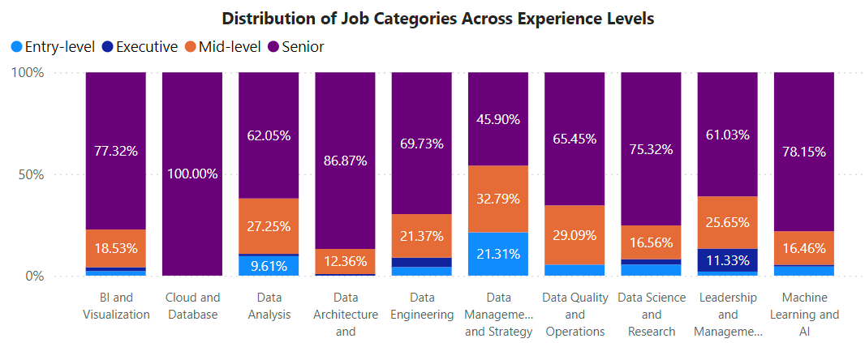
Visualization
Senior-level roles dominate most categories, over 50% of roles filled by senior professionals.
Mid-level roles have moderate job categories. Fields like Leadership and Management and Data Management and Strategy provide significant opportunities for career growth.
Entry-level positions are far fewer across all categories.
Notes:
This chart highlights the distribution of jobs across experience levels and categories.
As we can see, senior roles dominate in most categories, where over 50% of roles are filled by senior professionals.
Mid-level roles have moderate job categories. Fields like Leadership and Management and Data Management and Strategy provide significant opportunities for career growth.
Entry-level positions are far fewer across all categories.
Transition to next slide: Now, let’s examine how these roles align with different work settings, such as remote, hybrid, or in-person.

Slide 17
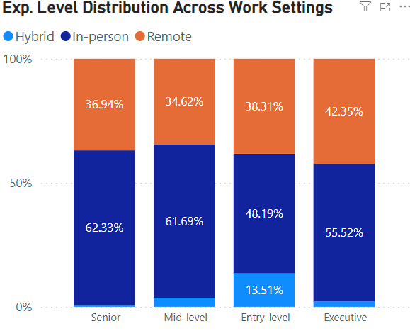
Visualization
Remote work is more prevalent for senior and executive roles, showcasing flexibility for experienced professionals.
Entry-level positions are pre-dominantly in-person.
Hybrid roles are evenly distributed across levels, but they are less common.
Notes:
This visualization breaks down work settings—remote, hybrid, and in-person—across experience levels.
We observe that remote work is more prevalent for senior and executive roles, showcasing flexibility for experienced professionals.
On the other hand, entry-level positions are predominantly in-person, likely because of the need for on-site training and collaboration.
Hybrid roles are evenly distributed across levels, but they are less common overall compared to remote or in-person settings.
Transition to next slide: Now that we’ve looked at work settings, let’s shift our focus to job title popularity over the years to see emerging trends.

Slide 18
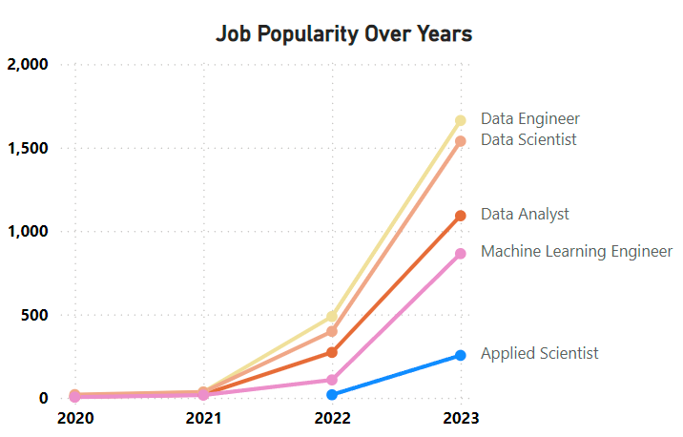
Visualization
"Data Engineer" shows consistent growth over the years, signaling its increasing importance in data-driven organizations..
"Machine Learning Engineer" has rapidly gained popularity, reflecting the rise of AI technologies.
"Data Analyst" roles have stabilized, with less growth compared to other technical roles.
Emerging trends highlight a shift toward advanced and specialized technical roles.
Notes:
This line chart depicts the popularity trends of key job titles over the years.
As we can see, Data Engineer, Data Scientist, and Machine Learning Engineer roles have shown consistent growth, reflecting the industry's increasing reliance on data infrastructure and AI technologies.
These trends emphasize the need for professionals to align their skills with emerging areas like AI and machine learning.
Transition to next slide: Lastly, let’s take a look at how salaries vary by region to identify global opportunities.

Slide 19
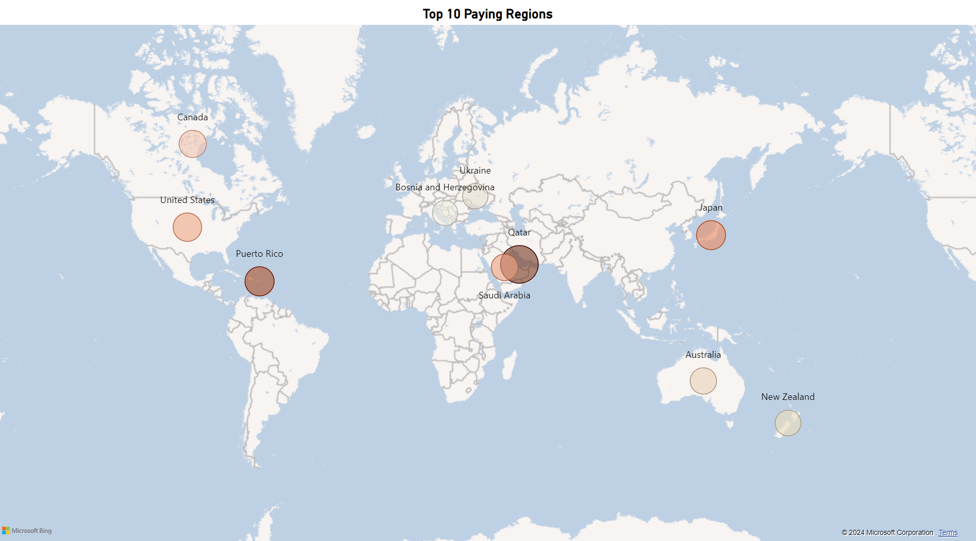
Visualization
The Qatar offers the highest average salary in USD, significantly outpacing other regions.
Puerto Rico and Japan second and third, reflecting emerging and established markets, respectively.
Regions like Ukraine and Bosnia have the lowest average salaries, reflecting differences in market maturity and cost of living.
Salary disparities highlight the importance of regional demand and economic factors.
Notes:
This chart highlights the regions offering the highest average salaries for data roles.
The Qatar clearly leads, with average salaries far exceeding those of other regions.
Regions like Puerto Rico and Japan follow, showcasing both emerging and established markets for data professionals.
Meanwhile, Ukraine and Bosnia represent regions with the lowest average salaries, reflecting economic and market maturity differences.
These insights help professionals identify high-paying regions to target for career growth.
To summarize, these visualizations provide key insights into salaries, job demand, work settings, and regional opportunities. They highlight the growing importance of data engineering and AI roles, the dominance of senior-level positions, and the value of aligning skills with high-growth opportunities.
Transition to next slide: Now that we’ve explored the key insights from the individual charts, let me show you how the dashboard brings everything together into a cohesive, interactive tool.

Slide 20
DEMO

Slide 21

Dashboard
Notes:
Dashboard allows users to explore data dynamically and customize their analysis based on specific needs.
Let's walk through how the charts work together.
Look at the Distribution of job categories charts how it impacts rest of the dashboard.
Explore some examples. Start with Distribution of job categories, then with top 10 paying regions charts.
This dashboard is designed to be user-friendly, to provide actionable insights and enhance decision-making for both individuals and organizations.
Transition to next slide: With that, I’ll now hand it over to [next presenter] to continue with the presentation.

Slide 22
R SHINY
Notes:
To understand the future of the data science field especially in terms of salaries we decided to build a prediction model using R Shiny

Slide 23

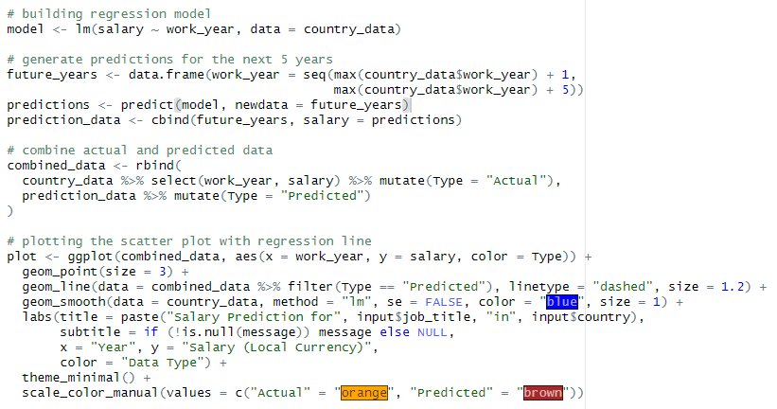
Prediction Model
Objective : To provide an interactive analysis of salary predictions for various job roles across different countries and enable users to explore actual and predicted salary trends over time.
Model Building : Used Rshiny to build a linear regression model(lm) using historical salary data (salary ~ work_year).
Future Predictions : The model generated salary predictions for the next 5 years by extrapolating from the last available year in the dataset.
Notes:
We built a linear regression model that plots a scatter plot with a regression line to show the trends in salaries for the next 5 years.
The r shiny model uses 3 columns- countries, job title and salaries from our dataset and predicts the salaries based on the selected metrics.
Since we all are majoring in Data Analytics, we decided to look into prediction models for Data Engineers, Scientists and Analysts.

Slide 24
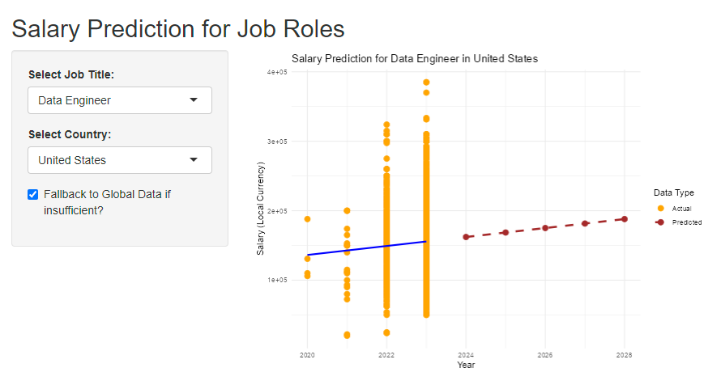
Prediction Model
A steady growth trajectory is observed for Data Engineer Role.
The predicted values (brown dashed line) shows potential salary increases post-2023.
Outliers and clusters in actual salaries indicate a range of compensation based on factors like experience or location.
Notes:
We first analyze the prediction chart for Data Engineer Role. Here the prediction chart displays actual salaries from 2020 to 2023 and predicted trends in the next 5 years.
The salary prediction shows a steady growth trajectory which means there will be potential salary increases post 2023.

Slide 25
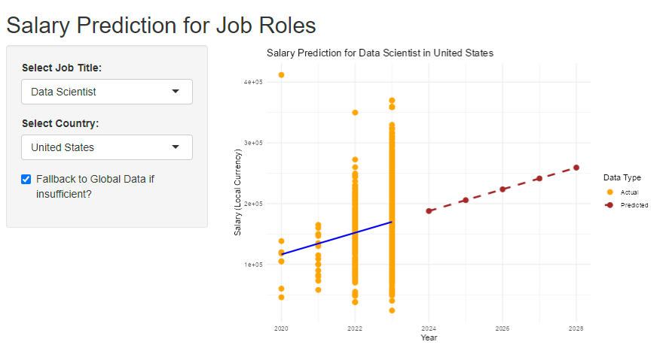
Prediction Model
The Data Scientist trend line (blue line) shows steady growth, similar to Data Engineer salaries, but with slightly less variance in the actual data points.
Compared to Data Analyst salaries, the growth trend is steeper, indicating a stronger demand and value for data scientists over time.
Notes:
For Data Scientist we can observe that the growth trend for predicted salaries is much steeper than Data Engineers which tells us that there’s a stronger demand and value for data scientists over time.

Slide 26
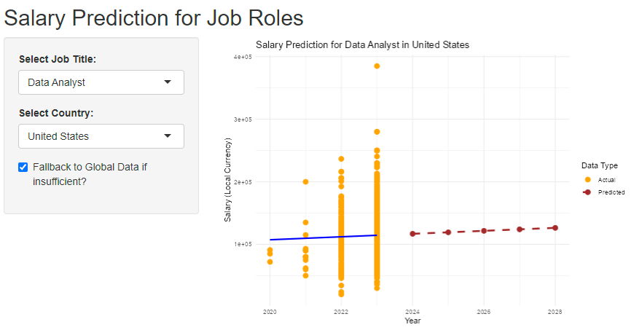
Prediction Model
The growth trend is relatively flat, indicating slower salary progression over time.
The predicted salaries (brown dashed line) suggest a steady but minimal increase beyond 2023.
The range of salaries is narrower, suggesting less variability in compensation
Notes:
For Data Analyst, the growth trend is relatively flat which indicates that the salary progression is much slower in the upcoming years.

Slide 27
DEMO

Slide 28
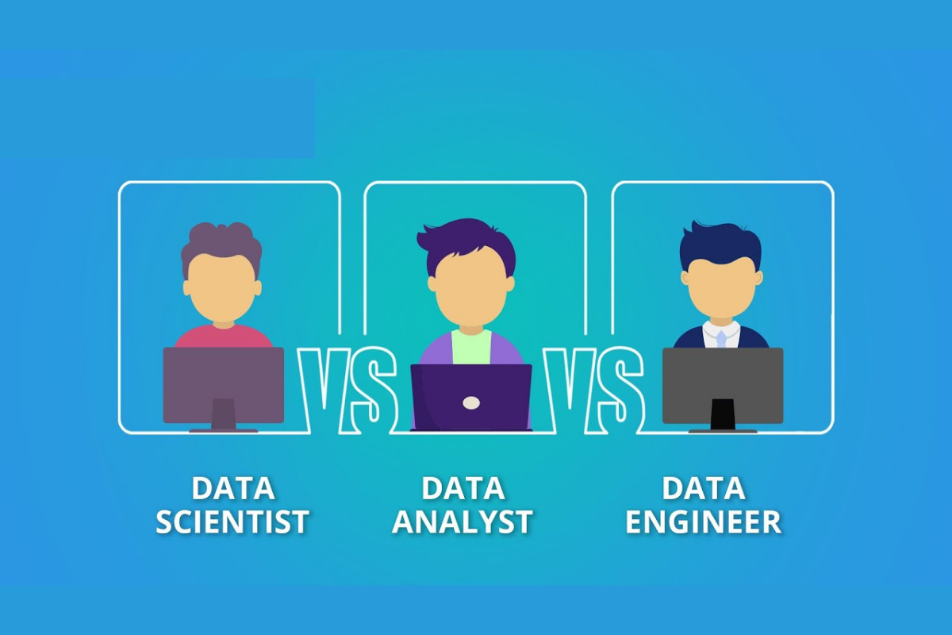
Key Takeaway
Data Scientist : Strongest salary growth over time, driven by high demand and advanced skill requirements. High salary variability with opportunities for top earnings in specialized roles.
Data Analyst : Stable salary trends with moderate growth, indicating consistent demand. Narrower salary range, offering predictable and steady compensation.
Data Engineer : Significant upward salary trends, reflecting the growing need for technical expertise in data infrastructure. Noticeable salary variability, offering lucrative opportunities in senior or niche roles.
Notes:
Data Scientists lead the pack with the highest salary growth, driven by high demand and advanced skills, offering top earning opportunities despite salary variability. Data Analysts, on the other hand, provide stability with steady salary trends and predictable compensation, making it a reliable career choice. Meanwhile, Data Engineers are experiencing rapid salary growth as the demand for infrastructure expertise rises, with senior and niche roles offering significant earning potential. Each role caters to different career aspirations, whether it’s leadership, stability, or growth. So Jeff, since you mentioned that we have 0 job interviews in 2024 we have some steps you can take in order to land some interviews next year.

Slide 29

Your Next Steps
Focus on High-Demand Roles.
Adapt to Regional Opportunities
Plan for Career Growth
Prepare for Emerging Trends
Notes:
To conclude, we’ve gained valuable insights into salary trends, highlighting disparities and growth patterns across roles and experience levels. Moving forward, there are several next steps we recommend.
"The first step is to focus on high-demand roles like Data Engineer, Machine Learning Engineer, and Data Scientist, as these offer the greatest growth potential and salary opportunities."
"Next, adapting to regional opportunities is essential. Regions like Qatar and Japan offer some of the highest average salaries, and aligning your career goals with such locations can be a game-changer."
"Third, planning for career growth means upskilling continuously. As the data industry evolves, staying ahead requires a commitment to acquiring advanced technical skills."
"Finally, preparing for emerging trends, such as advancements in AI and data analytics, positions you at the forefront of innovation."
These next steps would not only enrich this study but also make it more actionable for both job seekers and organizations.
"

Slide 30
Thank You
Notes:
With this, we conclude our project presentation. Thank you for your time and attention, and we’re happy to take any questions or explore these ideas further.

